Slide 1
Dissertation Writing:
Workshop 2

Slide 2
Facilitator Details
Ms Suveera Singh
031 – 304 4626
N.B: Khatija Haniff: researchadmin@regent.ac.za

Slide 3

Dissertation
Structure

Slide 4
Cover page
Title page
Abstract
Declaration
Acknowledgements
Table of Contents
List of Tables
List of Figures
List of Acronyms
Chapter 1 – Introduction
Chapter 2 – Literature Review
Chapter 3 – Research Methodology
Chapter 4 – Results, Discussion and Interpretation of Findings
Chapter 5 – Conclusions and Recommendations
Bibliography
Appendices

Slide 5
CHAPTER ONE - INTRODUCTION
Introduction
Background to the Problem
Problem Statement
Aim of the Study
Objectives of the Study
Research Questions
Significance of the Study
Format of the Study
Conclusion

Slide 6

CHAPTER TWO

Slide 7

What is a Literature Review?
A review that encompasses the theoretical, descriptive and empirical work that exists on your topic area
Explores previously conducted research as well as ‘gaps’ that exist
Specific in focus

Slide 8
Purpose of the Literature Review:
To provide a theoretical framework for the research;
To familiarise the researcher with current issues and contemporary knowledge on the topic;
To identify silences or gaps in the knowledge and to comment on what is yet to be studied or improved;
To compare the investigations and results of different research;
To study the definitions used
in previous research projects
and to adopt them;

Slide 9
Maintain an academic style of writing
Write formally, clearly, concisely and unambiguously
Avoid colloquial and conversational language such as:
  ‘I think that….’;
  ‘Everyday we see changes in the business environment..’;
  ‘There are lots of studies that focus on…’

Slide 10
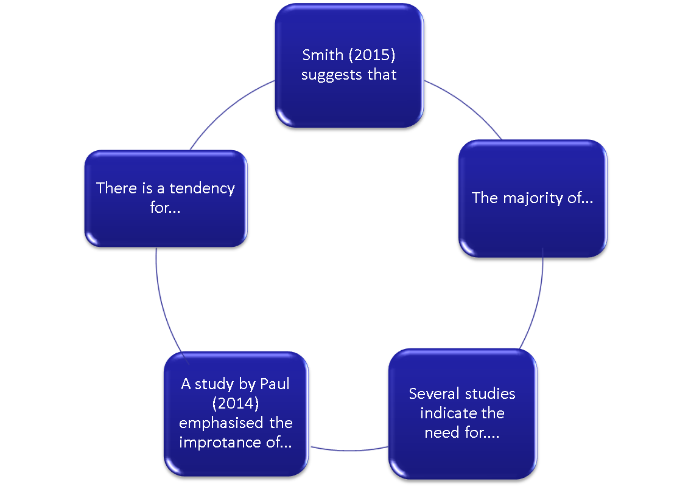

Slide 11
Requirements of a Literature Review:
How do we select content of the literature review???
  CONTENT: Content must be based on information relating to research objectives
  Use objectives to guide the development of headings and subheadings
  Include a theoretical framework which should be 4-5 pages. Do not simply summarise the theory- you need to engage with it and illustrate its relevance to your study
RELEVANCE: All content should be relevant to your study area
Do not dominate your literature review with a few sources
Engagement

Slide 12
References:
Ensure accurate in text referencing
Ensure that references are in alphabetical order on the reference page and correct style of referencing is used.
Internet referencing must also be cited accurately
Ensure all references are credible and valid.
References should not be older than five years from current date.
Please ensure that all numbering, sub-headings and general layout is uniform and consistent
Refer to checklist in dissertation writing guide

Slide 13
Font: New Times Roman with 1.5 line spacing
Length: Each literature review chapter should be between 20-25 pages.
Ensure that all sources used within your dissertation are cited in your main reference list!

Slide 14
Where do I search for Literature?
Books
Journals
Online Journals (Ebscohost; Google Scholar; Academic Search Complete; Sabinet etc.)
CREDIBLE Internet sources
Refrain from sources such as: Wikipedia, Dictionary.com; Yahoo answers.com; encyclopedia.com etc.

Slide 15
Example: Structure of a Literature Review:
The structure will vary depending on YOUR research topic, aims and research objectives.
Introduction
Key Terms/Definitions and Concepts (This is an example)
Generate further sub-headings based on key themes of research study:
  Examples:
  Factors Affecting Training and Development
  Benefits of Training and Development
  Costs of Training and Development
  The Impact of Training on Employee Performance/Organisational Performance
Theories
Conclusion

Slide 16
Searching for Literature
Examine Research objectives
Define parameters (scopes and boundaries)
Generate & refine key words
Conduct search
Obtain Literature
Evaluate
Record
Start draft
Redfine parameters (scopes and boundaries)
Conduct search
Obtain Literature
Evaluate
Record
Update & revise draft
Process to be repeated until literature review is complete

Slide 17

CHAPTER THREE:
RESEARCH METHODOLOGY

Slide 18
Structure of Chapter 3
Introduction
Research Philosophy
Research Strategies
Target Population
Sampling
Research Instrument
Questionnaire Construction
Interviews
Pilot Study
Administration
Collection of questionnaires
Data Analysis
Validity and Reliability
Limitations
Elimination of Bias
Ethical considerations

Slide 19
Chapter 3
It is imperative for the various research methodologies (for each subsection) within chapter 3 to be:
  Fully explained and supported with references
  Supported by sufficient rationale/reasons for chosen methods to be highlighted
Relevance to your research study to be illustrated

Slide 20
Research Methodology
Research methodology refers to the theory of how research should be undertaken.
It is a systematic way to solve a problem.
Emphasises that although research may be a logical approach to solving a problem, it is a very systematic process which specific methodologies adopted in order to conduct a study.

Slide 21
Structure of Chapter 3 (R.M)
Introduction
Research Methodology is defined as…
This chapter introduces the research methods adopted in this study…
These include……

Slide 22
Research Philosophy
Whilst discussing the differences between two main research paradigms (i.e. Positivists and Phenomenological paradigms), this section also needs to include the research paradigm that your study uses
Discuss the appropriateness of choice (include advantages).

Slide 23
POSITIVIST PARADIGM | PHENOMENOLOGICAL PARADIGM
Tends to produce quantitative data Uses large samples Concerned with hypothesis testing Data is highly specific and precise The location is artificial Reliability is high Validity is low Generalizes from sample to population | Tends to produce qualitative data Uses small samples Concerned with generating theories Data is rich and subjective The location is natural Reliability is low Validity is high Generalizes from one setting to another

Slide 24
Research Strategy
Refers to the various strategies that you may adopt in your study.
E.g. Survey strategy; case study; exploratory; descriptive etc.

Slide 25
Target Population
Identify the full set of elements that you have identified for your study.
E.g. if you wish to conduct a study of women between the ages of 21-30 at Regent Business School, your target population will be ALL the women between 21-30 employed at the school.
    Relevance of target population to study
    Define target population
    Specify size of target population
    Specify size of sample

Slide 26
Sampling
Specify your sample size
Identify a sampling design. Non-probability vs. probability. (Refer to detail on Workshop 1 slides)
Criteria?

Slide 27
Probability & Non-Probability Sampling
With probability sampling, the likelihood of any one member (or element) of the population being selected, is known.
In non-probability sampling, the exact number of elements in the population is unknown with the result that the likelihood of selecting any one member of the population is not known.

Slide 28
Research Instrument
Choice of research instrument depends on research philosophy, i.e. whether your study is qualitative or quantitative.
Questionnaire or interviews? Both?

Slide 29
Questionnaires vs. Interviews
The two most commonly used primary data collection methods are the questionnaire and the interview.
The questionnaire and interview are data collection instruments that enable the researcher to pose questions to subjects in his/her search for answers to the research questions.
Both these instruments, however, have distinct features that have a bearing on the correct and appropriate use of each for specific data collection purposes.

Slide 30
Interviews:
Interviews do not require large samples.
The subjects are often deliberately selected for their experience and specialist background and thus constitute a purposive sample.
Structured Interviews:
Pros and cons?
Interviewer asks questions and respondent answers.
Only the respondent reveals feelings and opinions.
Interviewer tries to obtain direct answers to specific questions
Interviewer avoids making ritual responses that influences a respondent and also seeks genuine answers, not ritual responses.

Slide 31
Unstructured Interviews
Unlike structured interviewing, the interviewer in unstructured interviews simply suggests the general theme of discussion and poses further questions as these emerge in the spontaneous development of the interaction between interviewer and interviewee

Slide 32
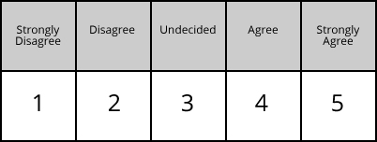
Questionnaire Construction
How was your questionnaire designed?
Sections? Themes? Content used?
Scaling (e.g. Likert Scale?)

Slide 33
Open-ended (qualitative)
Closed-ended (quantitative)

Slide 34
Interviews:
Type of interview? Structured-semi structured- unstructured?

Slide 35
Pilot Study
Make amendments necessary to maximise returns and minimise the error rate on answers.
Categorise the open-ended questions to a reasonable degree.
Perform the analysis on the pilot sample and test out all the computational procedures and produce some initial hypotheses.

Slide 36
Evaluate the adequacy of the data for the research questions.
All findings and amendments made to the original instrument must be explained
Note: All findings and amendments made to the original instrument must be explained in this section

Slide 37
Pilot testing
Before administering the questionnaire to participants in the study, the researcher must test it on a small sample.
The analysis of the pilot survey will reveal flaws in some questions, suggest possible improvements and supply a range of possible answers to open-ended questions.

Slide 38
Administration of Questionnaire
Method that was used to administer the questionnaires or conducting the interview process.
The questionnaires can be administered by face to face, email, etc.
Explain/justify the choice of the method/s chosen.

Slide 39
Collection of questionnaires
The collection of research instruments will include time frames given to respondents,
How was data collected?
Storage of questionnaires?

Slide 40
Data Analysis
    Qualitative or Quantitative?
    Rationale?
    Quantitative (Statistical techniques? Inferential: beyond description- judgements/conclusions can be inferred or explained; or descriptive statistics: describe basic features of data)
    Qualitative: Thematic analysis; Content Analysis; NVivo

Slide 41
Data Analysis
  The data analytic process must be explained procedurally from the time of data entry.
  Indicate the use of tables or figures to present findings.

Slide 42
Validity and Reliability
    Validity:Potential of a design or measuring instrument to measure what is supposed to achieve and or measure
    The researcher must cite the following types of validity and then explain how he applied them to his instrument:
    Content validity (representation of all elements?)
    Criterion- related validity (is the measure related to outcome?)
    Construct validity (measures the theoretical construct?)
Reliability: extent to which tests are accurate & consistent

Slide 43
Limitations
Delimitations imply limitations on the research design that the student imposed deliberately.
These delimitations may include a restriction on the population for which the results of the study can be generalized e.g. your population may include only males in a certain age group.
Limitations refer to restriction on your study which you have no control.
For example you may be limited to a narrow segment of the total population you wish to study or you may be limited to the research method you have selected to use.

Slide 44
Elimination of Bias
This section will include a discussion of how the research remained objective throughout the study. The following areas may require explanation:
Use of gender neutral words
Identifying people by race or ethnic group unless it is relevant
Avoid language that suggests evaluation or reinforces stereotypes
Making assumptions about various age groups
Identify and explain the biases that were avoided, and how these were avoided.

Slide 45
Ethical Considerations
Ensuring Participants are given Informed Consent
Ensuring no Harm Comes to Participants
Ensuring Confidentiality and Anonymity
Ensuring that Permission is Obtained
  Ensure that a validated, official (on the company letterhead) written permission letter from the selected organization/company is obtained

Slide 46

CHAPTER FOUR
Results, Discussion, and Interpretation of Findings

Slide 47
Chapter Four Structure:
Introduction
Response Rate
Demographics
Presentation and Analysis:
  Sub-headings of this section to be guided by key research objectives
Conclusion

Slide 48
Whilst it is recommended that you utilise the use of graphs and tables to present your findings, it is important to discuss the meaning of the information provided in these graphical representations.
What do these ‘statistics’ actually mean in relation to the study’s objectives.
Implications for the organisation under study?
What are the impacts of the findings on the organisation? Positive? Negative?

Slide 49
Another important aspect to include is a correlation with findings from your literature review (chapter 2).
Utilising chapter 2 will also allow you to build a theoretical foundation to your primary findings.
Primary findings do not necessarily need to concur (i.e. agree) with findings from chapter 2.

Slide 50
CHAPTER FIVE
CONCLUSIONS AND RECOMMENDATIONS

Slide 51
Introduction
Findings from Literature Review
Findings from Primary Study
Conclusion to Findings
Recommendations
Areas for further research
Conclusion

Slide 52
Introduction
  Introduce sections to be covered by this chapter
Findings from Literature Review
  Align to research objectives
Findings from Primary Study
  Align to research objectives
  Were research questions answered?

Slide 53
Conclusion to Findings
  Overall conclusions per research objective
Recommendations
  What are the suitable/feasible strategies that can be recommended?
  Discuss ito objectives
Areas for further research
  Scope for further research
  Expansion of research?
  Methodologies?
  Topics?
Conclusion (overall conclusion)

Slide 54


Slide 55
Referencing
 | In-Text | Bibliography
Book | Smith (2015:58) claimed that … | Smith, D. (2015). Elements of Management. London: McMillan.
Electronic Journal | Johnson (2015) argued that democratic leaders welcome employee participation. Or Democratic leaders welcome employee participation (Johnson, 2015). | Author, initials. (Year). Title. Journal title [online], volume (issue), location within host. Available at: URL [Accessed Date]. Johnson, M. (2015). Leadership in Africa. African Journal of Management [online] vol. 87(5). Available at: http://commerceinfo.com [Accessed 5 October 2015].

Slide 56
Referencing
 | In-Text | Bibliography
Internet: Web document | Lane (2013) claimed that … Or Technology is advancing at a rapid rate in the workplace (Lane, 2013). | Author. Year. Title. Place: Publisher (if available). Available at: web address of document [Accessed: day Month year]. Lane, C. (2013). The future of professionalised work: UK and Germany compared [Online]. London: Anglo-German Foundation for the Study of Industrial Society. Available at: http://www.agf.org.uk/pubs/pdfs/1232web.pdf [Accessed: 10 May 2014].
Internet Website | The population of SA is 55.6 million (Statistics SA, 2016). | Statistics South Africa. (2016). Community survey. Available at: http://cs2016.statssa.gov.za/ . [Accessed: 10 May 2016].
Government Publication | According to the Department of Health (2014), the number of nurses employed | Department of Health. (2014). Choice and opportunity: primary care: the future. CM 3390, London: Stationery Office. Available from URL [Accessed Date].

Slide 57
Citing a Source within a Source
For example, if Paul's work is cited in a book by Hudson (2013) and you did not read Paul's original work, list the source you did read (in this case Hudson) in the reference list. Paul (cited in Hudson, 2013) indicated that training and development serve as retention factors. OR (Paul, 2012, cited in Hudson, 2013)

